Slide 1
SQL Server 2017 新功能
胡百敬
集英信誠資深合夥顧問
http://Byronhu.wordpress.com

Slide 2
企業可用於轉型的時間越來越少
100 年前，能列名在S&P 500大企業名單中的公司，平均壽命是 67 年
到了 2020 年代，S&P 500大企業之中將有75%是新公司
Source: BBC
Notes:
At the same time, the time to adapt to disruptions is shrinking
Compared to the past, what’s unique about the disruption happening today is the rapid pace of change. During past revolutions, firms had many years, even decades, to adapt. Today, that is no longer the case. One indicator of just how fast the landscape is changing is the longevity of companies on the S&P 500, an index of leading US companies.
Roughly a hundred years ago, the average lifespan of a company listed on the S&P 500 was 67 years. Today, that average lifespan of a company on the S&P 500 has decreased to just 15 years. This demonstrates that it is becoming harder for companies to stay in the lead, or even in business, for very long.
Experts believe that we’ll see this trend continue. Richard Foster, a Yale University professor and former McKinsey partner, predicts that in the next decade, only 25% of the companies currently listed on the S&P 500 will remain there, meaning the other 75% will be replaced by new companies. These new companies will be those that take advantage of innovative technological capabilities to rapidly gain ground in their chosen markets. Similarly, the existing companies that remain on the index will be those that rapidly innovate and evolve their businesses.
The bottom line is, today’s organizations must adapt quickly to change, using new technologies that fuel competitive advantage, or risk getting left behind. That’s why it’s imperative to make the most of big data, the cloud and intelligence capabilities, all of which help companies accelerate their speed of business through smarter decision-making and faster execution.
Statistics source:
BBC, 2012, quoting Richard Foster - http://www.bbc.com/news/business-16611040
"The average lifespan of a company listed in the S&P 500 index of leading US companies has decreased by more than 50 years in the last century, from 67 years in the 1920s to just 15 years today, according to Professor Richard Foster from Yale University. Professor Foster estimates that by 2020, more than three-quarters of the S&P 500 will be companies that we have not heard of yet."

Slide 3

維護並整合多套資料庫系統
投資在更新老舊應用程式上
滿足對提高成本效益的不斷要求
提供具有預測能力的分析工具
然而，要將技術和經營革新彼此結合並不容易
Notes:
But harnessing technology to disrupt isn’t easy
IT Decision Makers are looking to…
Secure and integrate heterogeneous systems
Invest to modernize legacy systems
Deliver on increasing performance/price demands
Providing predictive analytics with diverse data
整併升級
安全規範
新需求
效能
高可用性

Slide 4
完整而現代化的數據資產
資料來源
資料庫管理
資料深入分析
架構性
資料視覺化
資料整合
商業智慧
OLTP
企業營運的資料
MOBILE
ERP
LOB
無架構
資料倉儲
預測分析與人工智慧
圖表
社群
IoT
大數據分析
媒體
確保資料、存取動作、應用軟體的安全
安全防護
作業彈性
適用的平台、語言、地點
Notes:
Data Sources
The first challenge customers face is a diversity of data to manage.
Structured and Unstructured.
From ERP systems and mobile apps.
Sensor data, social data, media, data that shows relationships in between non-hierarchical objects.
<click>
Data Management
The second challenge that our customers are facing is you’ve got to manage this data which is constantly growing.
You’ve got to ETL it from one location to another, your operational data to your data warehouse. How many copies are you keeping, anyway?
What happens when you need to query across big data and operational data – do you have a strategy for data virtualization?
<click>
Data Insights
The third challenge customers are facing is the need to shape all this data, to create a single source of the truth—and reveal it to business users.
Once they have a core set of KPIs across their business, how can they reveal this to their users, easily and cost effectively?
Will they be able to see it on the go, or just at their desks? Can they create dashboards and share?
Can you provide the predictive analytics that the business needs to transform, or merely reactive analytics, looking in the rearview mirror?
<click>
Data Security
The fourth challenge customers face is how to manage and deliver all this data, across all these diverse systems, in a secure manner.
<click>
Flexibility
The fifth challenge is how to accomplish all your data goals, without being a blocker to productivity and application innovation.
How do you deliver on-premises and in the cloud?
Mobile apps?
The infrastructure to support the languages and platforms your developers want to use?
To balance all these competing needs is to manage the complete modern data estate.

Slide 5
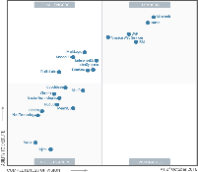

以 SQL Server 2017 推動完整數據資產
資料來源
資料庫管理
資料深入分析
架構性
資料視覺化
企業營運資料
資料整合
商業智慧
OLTP
榮獲連續四年產業領導
TPC-E 領導者
$2,230
在任何設備上的分析成本都僅有原本的一部分
MOBILE
ERP
資料倉儲
$480
LOB
$120
Microsoft
Tableau
擴大規模至PB等級
PB
TPC-H 最佳效能表現
#1
Oracle
無架構
#2
#3
預測分析
圖表
每秒進行 100 萬次預測
社群
大數據分析
{ }
對任何資料進行T-SQL 查詢
1010 0101
支援 R 與 Python
IoT
R
媒體
+
安全防護
連續7年榮獲最佳安全防護
SQL Server
SAP HANA
PostgreSQL
IBM DB2
Oracle
MySQL
作業彈性
任何語言、任何平台、任何地點
.NET
JAVA
Azure
3rd
The above graphics were published by Gartner, Inc. as part of a larger research document and should be evaluated in the context of the entire document. The Gartner document is available upon request from Microsoft. Gartner does not endorse any vendor, product or service depicted in its research publications, and does not advise technology users to select only those vendors with the highest ratings or other designation. Gartner research publications consist of the opinions of Gartner's research organization and should not be construed as statements of fact. Gartner disclaims all warranties, expressed or implied, with respect to this research, including any warranties of merchantability or fitness for a particular purpose.
National Institute of Standards and Technology Comprehensive Vulnerability Database update 2017.
TPC-H non-clustered results as of 2017 respectively. http://www.tpc.org/tpch/results/tpch_perf_results.asp?resulttype=noncluster
Notes:
要自己用原生的技術整合，還是在受管理的環境整合
Power your entire data estate with SQL Server 2017
Now we’ll look at all the reasons why SQL Server is the right database for your on-premises data estate.
Data Management - TDM
SQL Server is no longer just an OLTP database, it’s a mission critical OLTP database with industry-leading TPC-E performance benchmarks. It has been recognized by Gartner as a leader in Operational Database Management four years in a row, and THE leader in this quadrant for the last two years.
When it comes to data warehousing, you used to only be able to handle small data marts in older SQL Server versions. Today we have companies like NASDAQ who are doing petabyte scale data warehousing in a scale up SMP architecture just with SQL Server. Not to mention we have can support MPP architecture as well for very large data warehousing workloads. That’s tremendous value coming out of one enterprise SKU.
<click>
Data Sources
SQL Server 2017 not only has the great PolyBase technology for querying across structured data in SQL and unstructured data in Hadoop that we introduced in SQL Server 2016:
It now can handle even more types of data, with the introduction of graph data management and graph analysis to handle new, non-hierarchical relationships among your data.
<click>
Data Insights - BDM
BI (business intelligence) is an area in which everyone gave us lots of feedback, so we invested in it in a big way in the last release, SQL Server 2016. We’ve did a complete overhaul of SQL Server reporting services, refreshing to a modern report interface and adding new chart types like tree and sunburst.
And on top of that, we delivered an end-to-end mobile BI solution that not only works on Windows but also iOS, works on Android and, and beauty is it works online and offline. So it’s a comprehensive solution again being delivered out of that one SKU.
And if you choose to use Power BI, our cloud-based business analytics service that enables anyone to visualize and analyze data with greater speed, efficiency, and understanding, you can connect users to a broad range of live data through easy-to-use dashboards, interactive reports, and compelling visualizations –all at a fraction of the cost of our competitors.
And in SQL Server 2017, we have added many enhancements to SQL Server and analysis services (SSAS) as well, enabling you to mash up data from many sources,
In today’s world, businesses are trying to get predictive. Instead of reacting to data they want to pave their business path forward with data. The way to do that is with advanced analytics. From predicting optimal warehousing to sales forecasting to customer behavior, customers want to build predictive models based on data. And with SQL Server, you don’t have to take data out of the database to do advanced analytics. With Microsoft’s Machine Learning Services, you can do R and Python-based analytics, at scale and in a highly parallelized way, right in the database for Real time analytics at up to 1M predictions per second.
<click>
Data Security
Now let’s talk about security. You can see why we are saying we are the most secure database. This is from NIST, National Institutes of Standards and Technology and over the last seven years, SQL Server has least vulnerabilities of any database tracked by NIST. You can see the bars there with our number of incidents compared to competitors: Less than SAP HANA, which has only been tracked for half of those years. Less thank Postgres. Less than DB2. Far less than Oracle and MySQL.
<click>
Flexibility
Now that you see the scope of what SQL Server can address from a workloads perspective, also that only Microsoft can provide a consistent experience for all these workloads, from on-premises to the cloud, with applications in any language, and across platforms including Windows, Linux, and Docker. Any language, any platform, anywhere.

Slide 6



SQL Server 2017
可以執行在任何平台上，可以自行選擇語言開發應用程式
經由支援圖形物件和查詢分析複雜的關係
藉由 R & Python 完成進階的機器學習
彈性查詢處理提供更佳的效能
SQL Server 2017
最先進、安全、智慧的資料平台
Notes:
Run anywhere and build apps using the language of your choice
Analyze complex relationships with support for graph data
Advanced Machine Learning with R & Python
Unparalleled performance with adaptive query processing

Slide 7
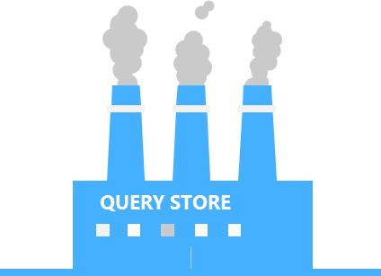

查詢儲存區
廣泛的查詢效能資訊
資料庫的飛行記錄器：
查詢、執行計畫、編譯和執行的統計資訊隨手可得
讓你迅速、簡單地確認並修正效能問題
適合如下的場景:
找尋變慢的查詢
確認最耗資源的查詢
Ad-hoc 負載的最佳化
平順升級應用程式
查詢存放區
?
SQL Database
查詢
深入洞察
Notes:
SQL Server 2016 增加的功能
Query Store provides comprehensive query performance information when you need it most.
By collecting and presenting detailed historic information about all queries, Query Store significantly reduces the time to diagnose and resolve performance issues.
If a query generates a different plan, you can use Query Store to analyze the query plan changes, possible performance degradation, or force the system to use a particular plan for your query.
Lets you identify queries that used to perform well but are now performing poorly.
Troubleshoot in minutes
Find regressed queries
Identify top resource-consuming queries
最佳化 workloads as needed
Upgrade apps smoothly

Slide 8
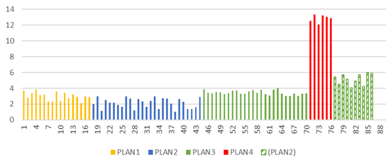
SQL Server 2017 自動調教
可以自動偵測與校正，而不需要手動介入
透過 sys.dm_db_tuning_recommendations 可取得調教建議的相關資訊
當偵測到效能退步時，可自動轉換到最後已知的較佳計畫
Notes:
https://docs.microsoft.com/en-us/sql/relational-databases/automatic-tuning/automatic-tuning
https://blogs.msdn.microsoft.com/sqlserverstorageengine/2017/04/19/introducing-interleaved-execution-for-multi-statement-table-valued-functions/
sys.dm_db_tuning_recommendations Returns detailed information about tuning recommendations.

Slide 9
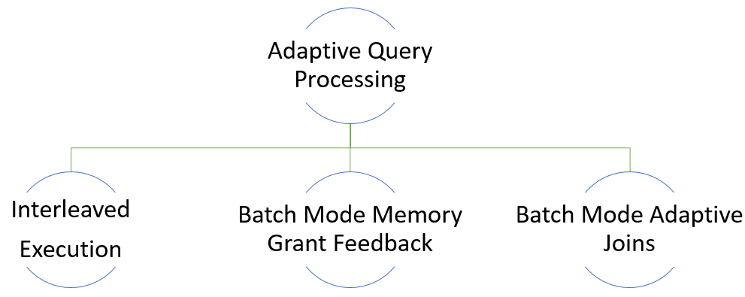
彈性查詢處理特性
Notes:
https://blogs.msdn.microsoft.com/sqlserverstorageengine/2017/04/19/introducing-batch-mode-adaptive-joins/

Slide 10
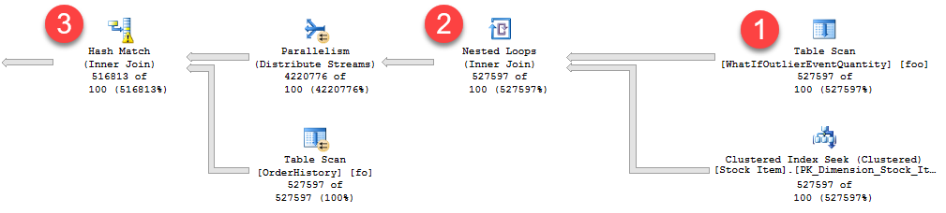
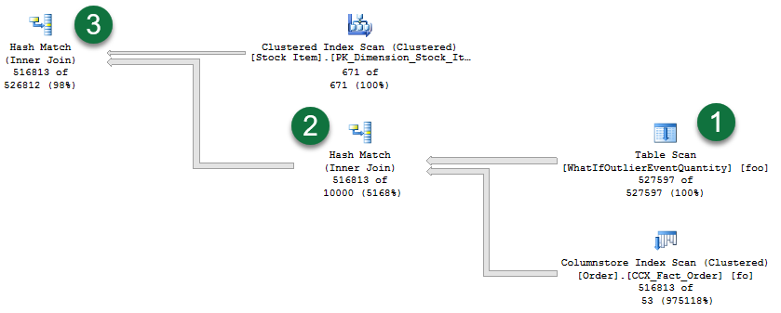

交錯執行
2017之前
最佳化
執行
問題: 多重陳述式資料表值函數 (MSTVFs) 是個黑盒子，僅是猜一個固定的紀錄數量後最佳化
交錯執行會從多重陳述式資料表值函數取得實質的紀錄數量
之後的運算子可以從校正過的估計紀錄數更換執行計畫
猜測 MSTVF 是100 筆記錄
可能造成嚴重的效能問題
2017+
釐清
MSTVF
執行
MSTVF
評估 500k 筆記錄
好的效能！
Notes:
Interleaved execution changes the unidirectional boundary between the optimization and execution phases for a single-query execution and enables plans to adapt based on the revised cardinality estimates. During optimization if we encounter a candidate for interleaved execution, which is currently multi-statement table valued functions (MSTVFs), we will pause optimization, 執行 the applicable subtree, capture accurate cardinality estimates, and then resume optimization for downstream operations. MSTVFs have a fixed cardinality guess of “100” in SQL Server 2014 and SQL Server 2016, and “1” for earlier versions. Interleaved execution helps workload performance issues that are due to these fixed cardinality estimates associated with multi-statement table valued functions.
The following image depicts a live query statistics ouput, a subset of an overall execution plan that shows the impact of fixed cardinality estimates from MSTVFs. You can see the actual row flow vs. estimated rows. There are three noteworthy areas of the plan (flow is from right to left):
The MSTVF Table Scan has a fixed estimate of 100 rows. For this example, however, there are 527,597 rows flowing through this MSTVF Table Scan as seen in Live Query Statistics via the “527597 of 100” actual of estimated – so the fixed estimate is significantly skewed.
For the Nested Loops operation, only 100 rows are assumed to be returned by the outer side of the join. Given the high number of rows actually being returned by the MSTVF, you are likely better off with a different join algorithm altogether.
For the Hash Match operation, notice the small warning symbol, which in this case is indicating a spill to disk.
Contrast the prior plan with the actual plan generated with interleaved execution enabled:
Notice that the MSTVF table scan now reflects an accurate cardinality estimate. Also notice the re-ordering of this table scan and the other operations.
And regarding join algorithms, we have switched from a Nested Loop operation to a Hash Match operation instead, which is more optimal given the large number of rows involved.
Also notice that we no longer have spill-warnings, as we’re granting more memory based on the true row count flowing from the MSTVF table scan.
Interleaved execution eligible statements
MSTVF referencing statements in interleaved execution must currently be read-only and not part of a data modification operation. Also, the MSTVFs are not be eligible for interleaved execution if they are used on the inside of a CROSS APPLY.
Interleaved execution benefits
In general, the higher the skew between the estimated vs. actual number of rows, coupled with the number of downstream plan operations, the greater the performance impact. In general, interleaved execution benefits queries where:
There is a large skew between the estimated vs. actual number of rows for the intermediate result set (in this case, the MSTVF), and…
…the overall query is sensitive to a change in the size of the intermediate result. This typically happens when there is a complex tree above that subtree in the query plan. A simply "SELECT *" from an MSTVF will not benefit from interleaved execution.

Slide 11
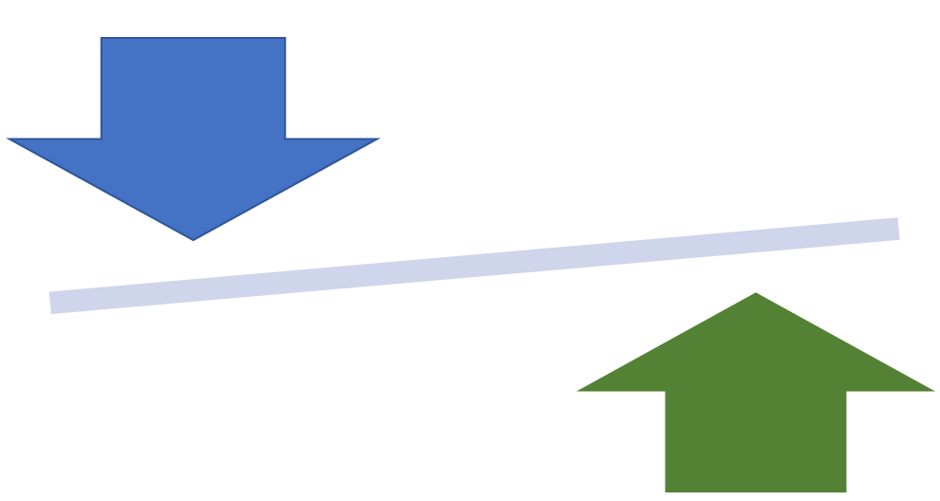
批次模式記憶體授與回饋
問題: 基於不佳的估計值會導致查詢需要暫存硬碟，或是配置太多記憶體
記憶體授與回饋會依執行回饋自動調整記憶體配置
記憶體授與回饋可以避免記憶體配置得不夠而需要寫入硬碟，或是配置過大而傷了同時存取
Notes:
相通的執行計畫，配合的參數不同，要預先配置的記憶體量不同。
這有點問題，若使用者查詢相同的執行計畫，多人存取的狀況是忽大忽小的資料量，符合的紀錄突然縮小，而下一個查詢變大，則下一個查詢就會卡住，要接續再下一個查詢才會使用到正確調整的記憶體量

Slide 12
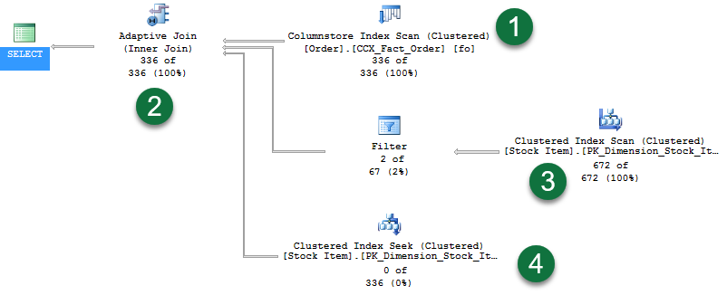
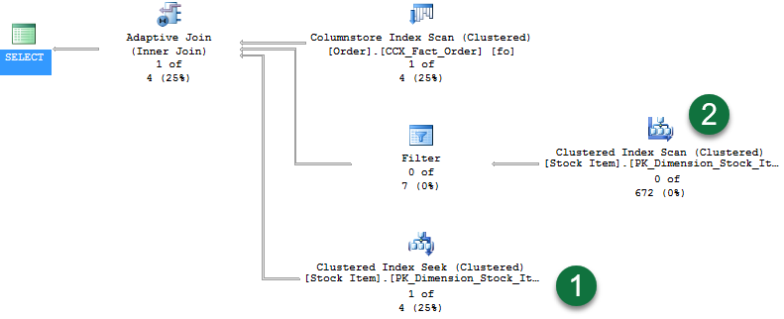
批次模式自適性聯結
讓選擇的雜湊聯結或巢狀迴圈聯結方法，延後到已掃描的第一個輸入「之後」
在執行期間動態切換至較佳的聯結策
如果輸入的資料列計數小到巢狀迴圈聯結比雜湊聯結更佳，則計劃就會切換成巢狀迴圈演算法
如果組建聯結輸入超過特定的資料列計數閾值，就不切換，計劃會繼續執行雜湊聯結
Notes:
https://blogs.msdn.microsoft.com/sqlserverstorageengine/2017/04/19/introducing-batch-mode-adaptive-joins/
一開始就同時備好 Hash Join 和 Nested Loop Join 兩種執行路徑，分別是右方第二條的 Clustered Index Scan(Hash Join)要用的，和右方第三條的 Clustered Index Seek(Nested Loop Join)用的。
當最右上方的紀錄查出符合的是 336 筆，適合做 hash join， Adaptive Join 運算子就只走右方第一和第二個運算，所以第三條是 0
當最右上方的紀錄查出符合的是 1 筆，適合做 Nested Loop Join，Adaptive Join 運算子就只走右方第一和第三個運算，所以第二條是 0

Slide 13
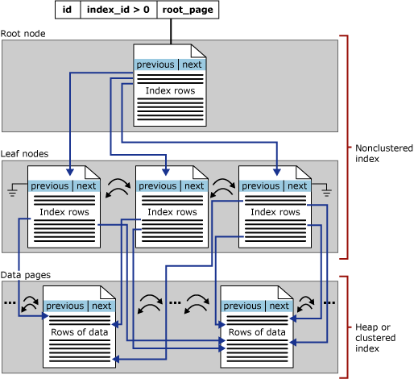
可繼續的索引作業
可因應中斷而不喪失維護作業的成果
不預期的損毀後，可繼續重建索引的作業
在任何時候暫停和回復建置索引作業，以釋放資源讓系統執行當下更優先的工作
支援線上重建大型索引而不需要大量的交易記錄空間，在重建索引時可以清掉交易記錄
不管復原模式是簡單、大量記錄、完整都可以

Slide 14
需求期待選擇
異質環境
多資料型態
不同的開發語言
企業內、雲端或混合環境
101001010010
{ }
T-SQL
Java
C/C++
C#/VB.NET
PHP
Node.js
Python
Ruby
Notes:
The business landscape is becoming increasingly diverse
Development and deployment environments include Windows, Linux, macOS, and Docker
Data is no longer relational, with companies accessing diverse data, including video, streaming, documents, relational, both external data and data internal to their org
Languages and frameworks are also expanding with the poularity of Node.js, Python, Ruby and others
Companies deploy on-premises, in the cloud, or both, with a hybrid solution

Slide 15
可依你對作業系統的需求選擇 SQL Server

Slide 16
強化 T-SQL
STRING_AGG 字串連接彙總
CONCAT_WS, TRANSLATE, TRIM 字串函數
新的 Japanese 定序
新的 BULK Insert 選項和 CSV 支援的選項 (包含 Azure Storage 和 RFC 4180 CSV 檔案支援)

Slide 17
In-Memory OLTP
對 In-Memory OLTP Tables 和原生編譯預存程序的 T-SQL 強化
支援 JSON
CROSS Apply
支援計算欄位
移除索引限制
支援 CASE
支援 Sp_rename/sp_spaceused
TOP (N) WITH TIES
提升 ALTER TABLE、容錯移轉等的效能
Azure VM 支援 In-Memory Checkpoint Files

Slide 18
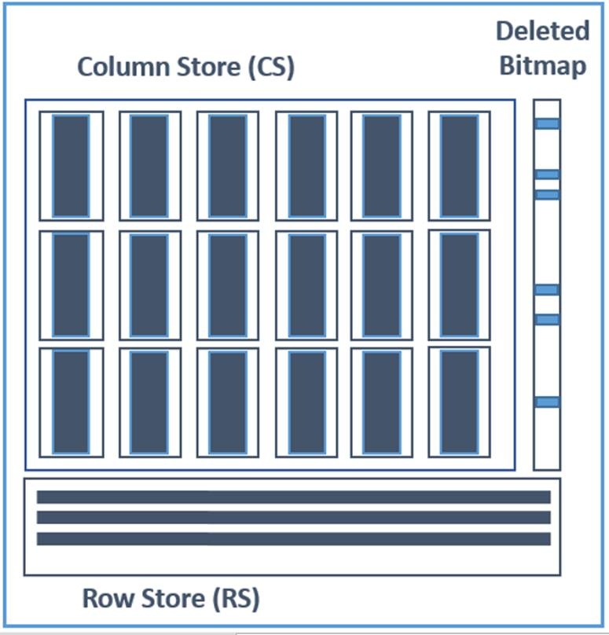
Columnstore
Clustered Columnstore 支援大型物件(LOB)資料類型(17.4 版的 SSMS 仍會禁止建立，要用語法)
大型物件可被壓縮，減少 DB 大小
可針對壓縮的內容查詢，提升效能
減少備份的時間
線上 Non-Clustered Columnstore Index Build/Rebuild
建立或重建索引不需要長時間的鎖定

Slide 19
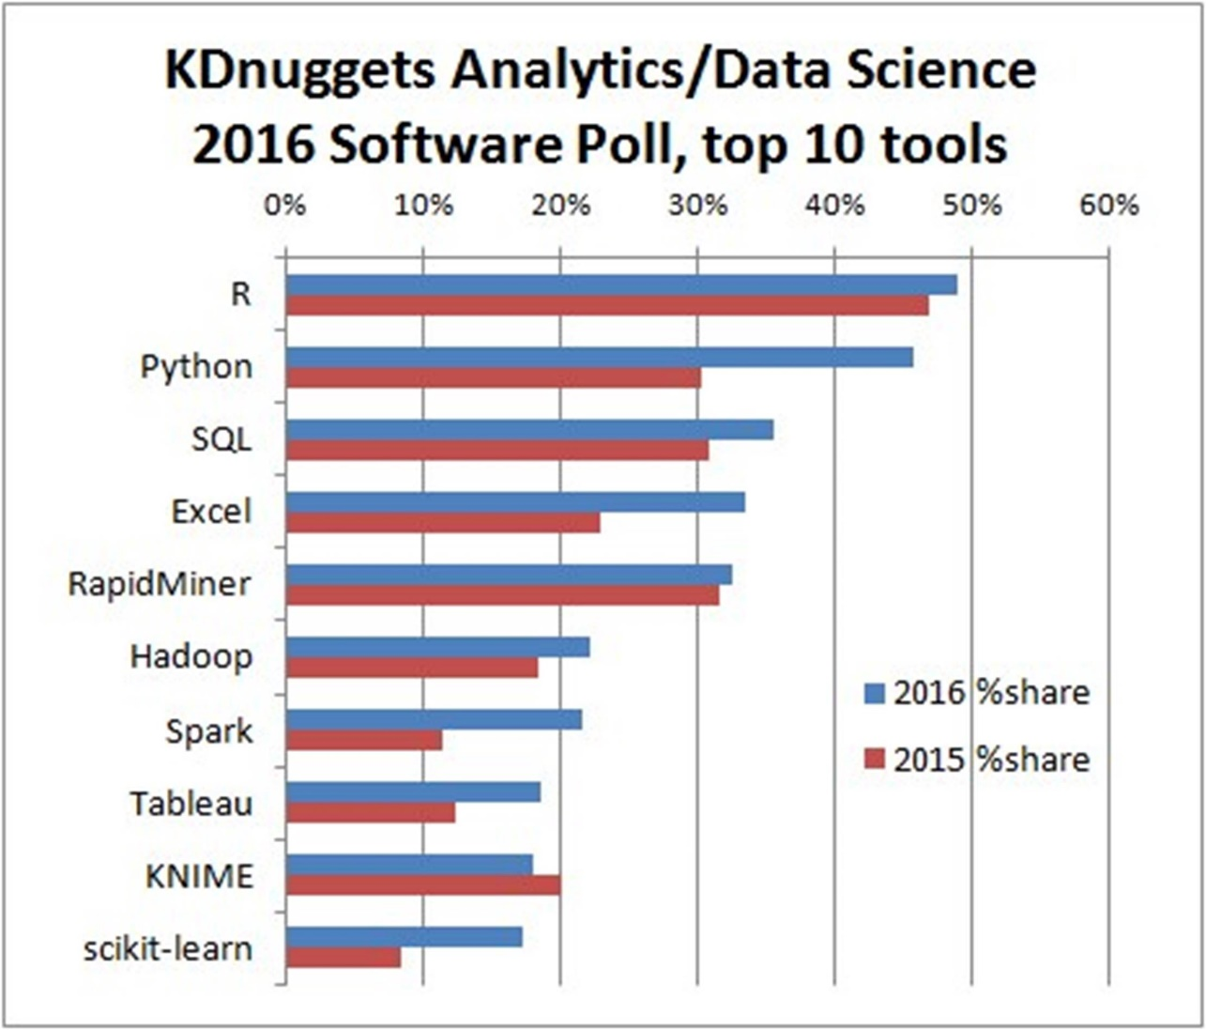

SQL Server Python
SQL Server 2016 導入 SQL Server R Services
SQL Server 2017 導入 SQL Server Python Services
兩種方式在 SQL Server 內執行分析:
從 Python 啟動並執行遠端作業
從 T-SQL 啟動，執行整合在一起的 Python script
安全和完整的管理功能
支援 SQL 和整合驗證
管理資源 (CPU & 記憶體等)
Source: http://www.kdnuggets.com/2016/06/r-python-top-analytics-data-mining-data-science-software.html
Notes:
https://www.youtube.com/watch?v=FcoY795jTcc

Slide 20
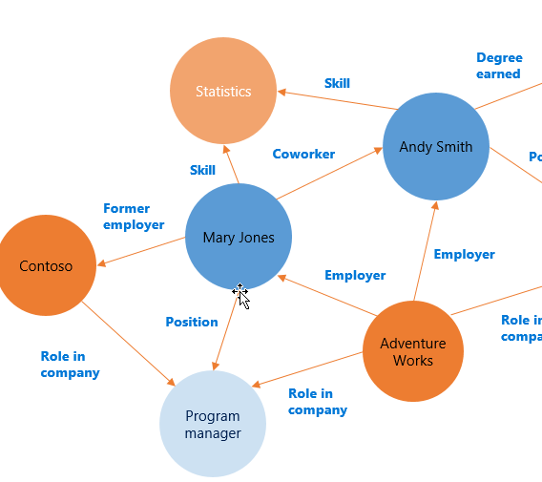
SQL Server 2017 支援 graph data
原生支援 nodes 和 edge 資料表
延伸查詢語言，不用 Join，提供 multi-hop 模式比對(pattern matching)的瀏覽
查詢橫跨一般的 SQL 資料表和 graph 資料
綜效 – 例如，支援 Columnstore 索引

Slide 21
Graph Database 術語
Nodes：本體 – 例如店家、人、產品
Edges：本體間的關係，連結 node 與 node 間的線
Properties 或 Attributes：與特定 node 和 edge相關的資訊

Slide 22


推薦引擎
情境範例
產品銷售資料
如果某個人 P 買了產品 A, 找尋朋友他的 P 也買了 A，及其買了其他那些產品，以此產生推薦
社群網路
與 Yelp 應用近似，尋找與我有相同喜好餐廳的朋友，建議他們所喜好的餐廳
Friends
location
hasBought
isLooking
sellsAt
Product
Notes:
Matured and trusted product
Columnstore, Advanced Analytics, ML, etc.
Both Relational and Graph, no ETL required
Will be available on Azure and on-prem
Security and Compliance

Slide 23
利用 SQL Graph 實作
UniqueUser
(node table)
UniqueSong
(node table)
Likes
(edge table)
CREATE TABLE UniqueUser (UserId VARCHAR(80))
AS NODE
CREATE TABLE Likes (ListenCount BIGINT))
AS EDGE
CREATE TABLE UniqueSong (SongId VARCHAR(50)
,SongTitle VARCHAR(500)
,ArtistName VARCHAR(500))
AS NODE

Slide 24
Q&A

Slide 25



Study4.TW
FB聊天社團
Study4.TW
FB粉絲專頁

Slide 26







特別感謝

Slide 27


Slide 28
補充

Slide 29
SSIS Scale out
分成 Master 和 Worker
設定完需要重新啟用對應的 Windows Services
Worker 註冊在 Master
Master 存放封裝定義，交給 Worker 執行，Worker 執行結果存 回 Master
Master 和 Worker 需要互相有對方 的憑證(在安裝時可以透過安裝 程式直接建立，但也可以使用自 己提供的)
Master, Worker
Worker
Worker
https://docs.microsoft.com/zh-tw/sql/integration-services/scale-out/walkthrough-set-up-integration-services-scale-out
Notes:
https://www.mssqltips.com/sqlservertip/4879/sql-server-vnext-sql-server-2017-ssis-scale-out-feature/
https://www.mssqltips.com/sqlservertip/4793/sql-server-2017-ssis-scale-out-configuration/

Slide 30
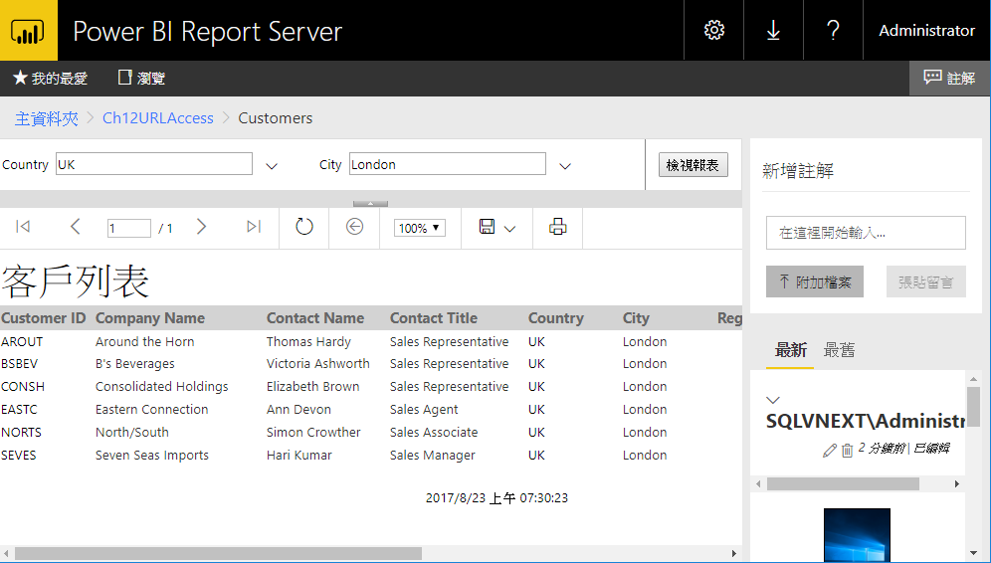
Reporting Services
目前改成獨立下載安裝
提供留言，可新增觀點並與其他人共同作業。 也可以在留言內包含附件
在最新版的報表產生器和 SQL Server Data Tools 中，可以藉由查詢設計工具拖放所需的欄位，來對Analysis Services表格式資料模型建立原生 DAX 查詢

Slide 31
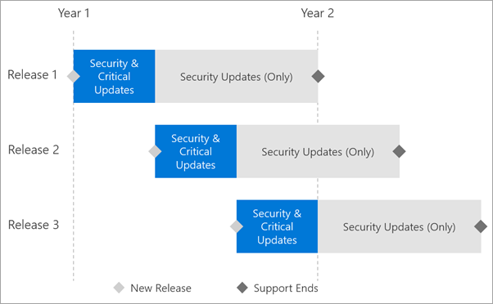
整合 Power BI
稱為 Power BI Report Server，其授權模式與單純的 RS 不同
獨立的發行、部署與技術支援
讓 Power BI 報表可以部署在企業內共享
目前只支援 Power BI Direct Query 查詢 Analysis Services
https://blogs.msdn.microsoft.com/sqlrsteamblog/2017/05/17/a-closer-look-at-power-bi-report-server/
Notes:
https://powerbi.microsoft.com/en-us/documentation/reportserver-support-timeline/
到下一個版本 release，既有版本就不再功能更新，但仍安全更新。EOF 是一年

Slide 32
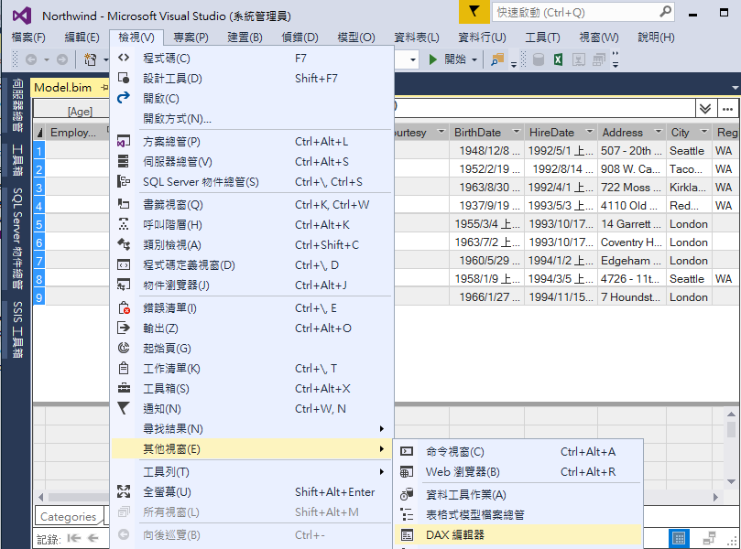
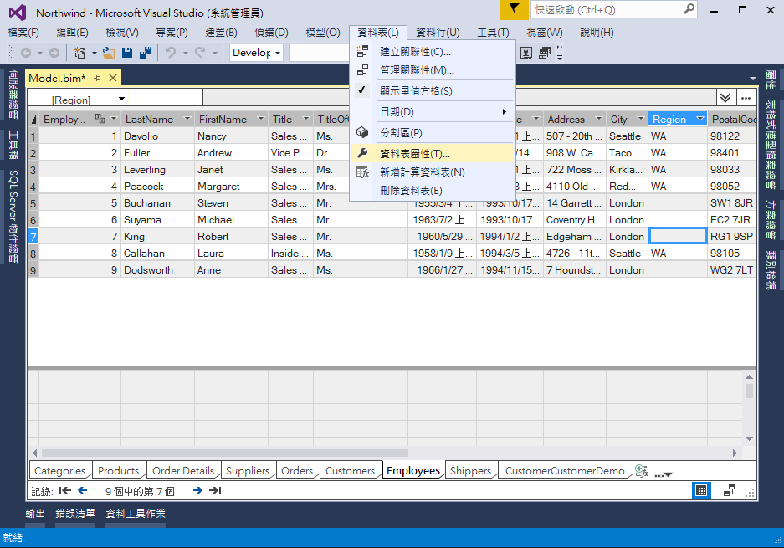
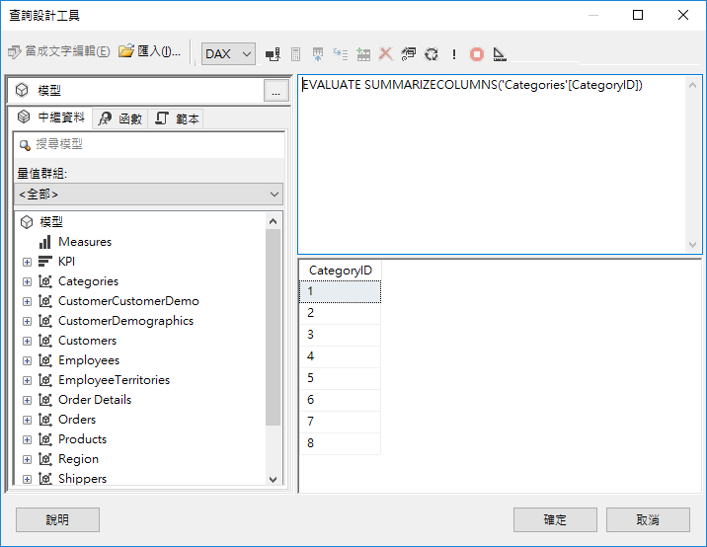
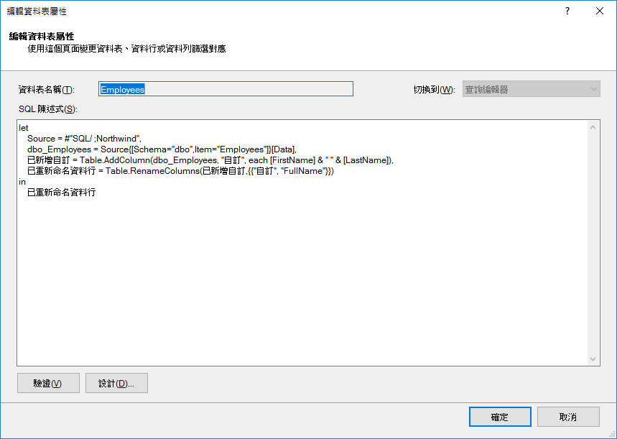
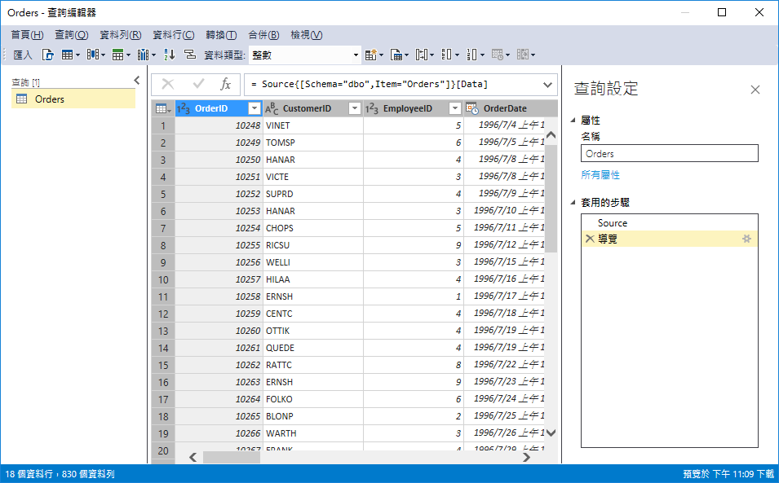
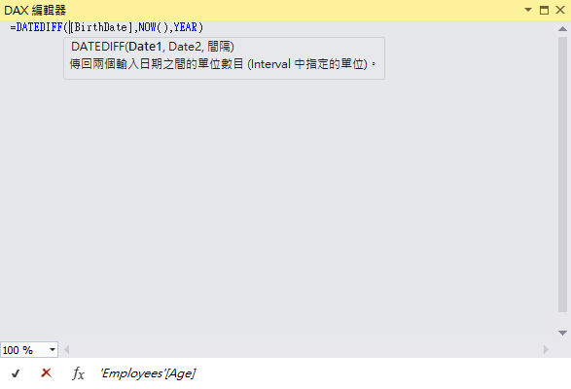
Analysis Services
查詢設計工具
可與 Report Builder 整合
SSMS DAX Query Editor
SSDT DAX 編輯器
資料來源可以整合 Power Query(mashup engine)
可以透過 M 語言直接整理多種資料源
Notes:
SSMS DAX Query Editor https://blogs.msdn.microsoft.com/analysisservices/2017/03/14/ssms-dax-query-editor/

